Slide 1
Introduction to Explainable AI
Helmholtz AI @ Helmholtz Summer School 2024
24.09.2024

Slide 2


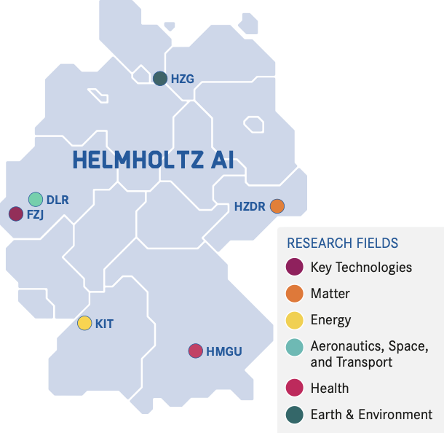



Who are we & what is our mission?
WHAT IS OUR MISSION?
Maximise research impact by democratising access to AI
Sabrina Benassou
HOW DO WE DO THAT?
Short- to mid-term scientific collaboration (2 weeks - 6 months)
Free of charge
Easy application
Isra Mekki
Elisabeth Georgii
Francesco Campi

Slide 3

Agenda
Ask your questions in the chat!
Introduction to eXplainable AI (XAI)
Track 1: XAI for Random Forests
Model-agnostic methods: Perm. Feature Importance, LIME, SHAP
Model-specific methods: Forest Guided Clstering
Comparison of XAI methods for Random Forest models
Track 2: XAI for CNNs
Model-agnostic methods: LIME, SHAP
Model-specific methods: Grad-CAM
Comparison of XAI methods for CNN models
Wrap-Up
GitHub Repository:
https://tinyurl.com/2uta6rdf

Slide 4
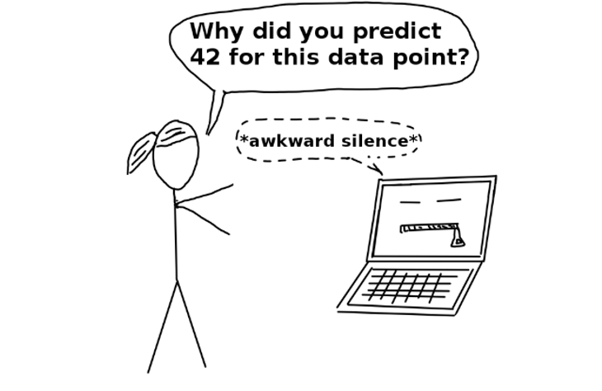
Introduction to eXplainable AI (XAI)
Terminology
Interpretability or Explainability?

Slide 5


Introduction to eXplainable AI (XAI)
Terminology
Interpretability
Understand exactly why and how the model is generating predictions by observing the inner mechanics of the AI/ML method.
Explainability
Focus on the decision-making process and try to explain the behaviour in human understandable terms.
In this course, we will focus only on eXplainable Artificial Intelligence (XAI).
Notes:
There is a difference between the two terms, even though they are largely used exchangably.
In a nutshell:
My idea of interpretability is that someone who uses the model, say a doctor, can interpret the interpretable model's behavior. Meaning they can "explain" (misleading terminology, sorry) why a certain model produces a certain output, given a certain input. Not all models can be interpretable models, most deep learning architectures can't.
My idea of explainability (or XAI) is that a certain method (typically what I'd call "model agnostic", but I will have to look into how you use this term in the rest of the lecture) provide additional information about how different parts of the inputs influenced the model's output. E.g. saliency maps. One XAI enriched output does not tell us anything about the model, but multiple might give us clues about the inner mechanics of the model.
I found this AWS whitepaper that somewhat does a decent job in distinguishing explainability or interpretability.
https://docs.aws.amazon.com/whitepapers/latest/model-explainability-aws-ai-ml/interpretability-versus-explainability.html

Slide 6
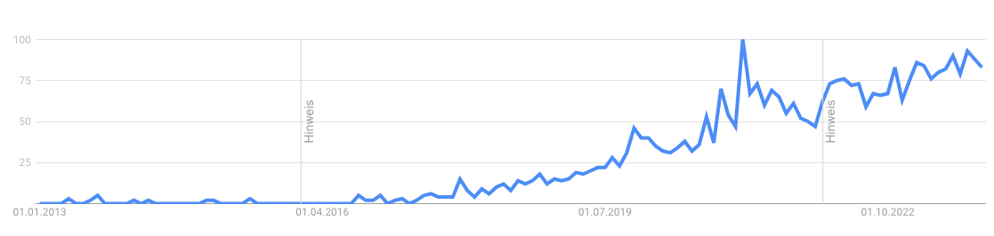
Introduction to eXplainable AI (XAI)
Why is explainability important?
Google Trends Popularity Index of the term "Explainable AI" over the last ten years (2013–2023)

Slide 7

Introduction to eXplainable AI (XAI)
Why is explainability important?
„The problem is that a single metric, such as classification accuracy, is an incomplete description of most real-world tasks.” — (Doshi-Velez et al., 2017)
Notes:
So, usually, we output the performance of machine learning models in metics. But, as Doshi-Velez et al. put it: a single metric always is an incomplete description of real-world tasks.
… and that leads to a bunch of problems. I will use the next few minutes to highlight a few areas where the lack of explainability creates problems, or - vice versa - the use of explainability can help better the results we achieve with machine learning.

Slide 8

Introduction to eXplainable AI (XAI)
Why is explainability important? For technological acceptance!
Notes:
First there is the issue of technology acceptance.
Imagine a doctor. If we hand them, for example, a machine learning generated prediction that their patient has cancer - say as a classification probability - in most cases the doctor doesnt know how the model generated the output.
Many doctors say that when they dont know how a recommendation came about, they cannot validate it, and hence, won’t trust it. As a result, they will disregard the models output and not use it to inform any decisions for their patients.
As you can imagine, this makes models that lack XAI extremely difficult to enter clinics.
When we use explainability, doctors can trace why a model outputs a certain result or why a certain recommendation has been made. That way, clinicians remain in the loop and can make an informed decision about if they would like to incorporate a machine learning result in their treatment decision or not.

Slide 9

Introduction to eXplainable AI (XAI)
Why is explainability important? To avoid ethical issues!
Notes:
A second - very important - reason to use XAI is to mitigate ethical issues.
In the case referred to in the image in the slide, the algorithm had been found to be “less likely to refer black people than white people who were equally sick to programmes that aim to improve care for patients with complex medical needs”.
How did that happen? It happens, because people have different characteristics. Think of - as in the example in the slide - skin color. But you can also think of other attributes, like age, gender, socio-economic status, access to medical care, trust in the healthcare system, etc..
When we train a machine learning model, it will always perform better for groups that share certain characteristics with the mean of the training data set and, hence, worse for others. What may result is bias, and potential discrimination.
When XAI is applied, specialists working with the system have the chance to spot if a given output might be underpinned by a bias prevalent in the model. Such insights can help to reject individual recommendations that are off, and even to find global errors in the model, to increase performance among socially disadvantaged groups.

Slide 10
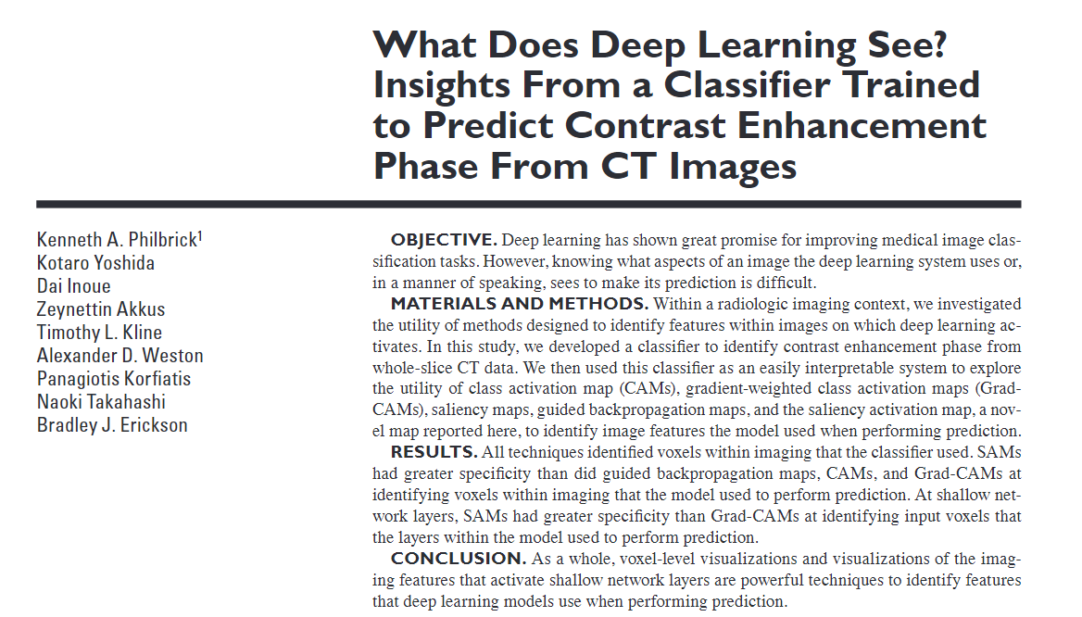
Introduction to eXplainable AI (XAI)
Why is explainability important? For knowledge creation!
Notes:
And then there is a self-sustaining reason to implement XAI: As humans we are just curious about new knowledge, and we want to know not just what the answer is, but why!
When we apply XAI to our machine learning models we get the chance to understand how certain factors impact the recommendations derived. In cases like this study you see on the slide, this creates new, actually so interesting that publishable, insights about what features are most interesting for a model when performing a prediction.
There are also examples of how insights learned from the behavior of a model lead to improvement on the design of a classifier (Ming2017).

Slide 11
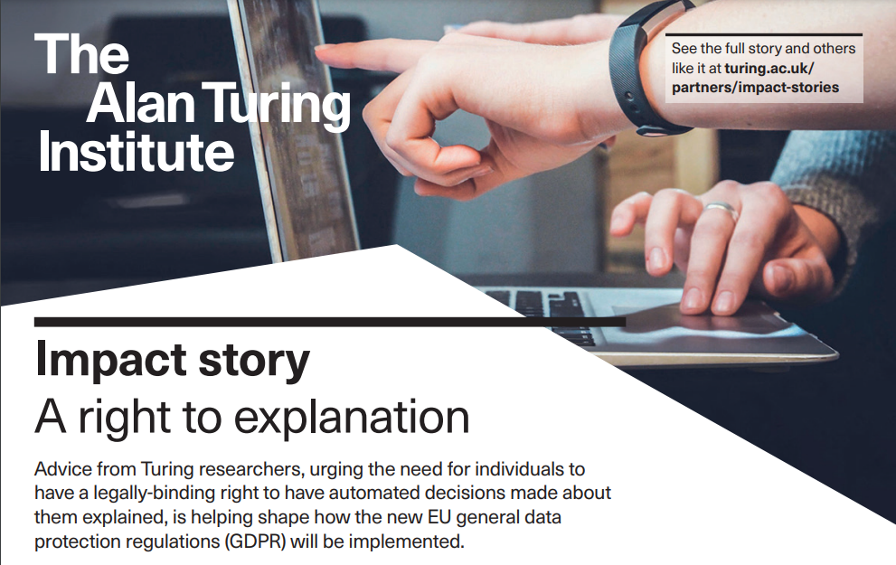
Introduction to eXplainable AI (XAI)
Why is explainability important? To meet regulatory requirements!
Notes:
Next - XAI is just important to fulfill regulatory requirements.
You might have heard about the General Data Protection Regulation (GDPR). It was enacted in 2018.
Article 15 constitutes that people have the right to obtain information about how their data is being processed
The Members of the European Parliament recently adopted this idea in the European AI Act, advocating to “boost citizens’ right to file complaints about AI systems and receive explanations of decisions based on high-risk AI systems that significantly impact their rights” [3].
So, it is the duty of those who use the data to be able to give such information upon request. XAI methods, thus, can not only help retrieve information about how a black-box algorithm operates but also help fulfill this legal duty.

Slide 12
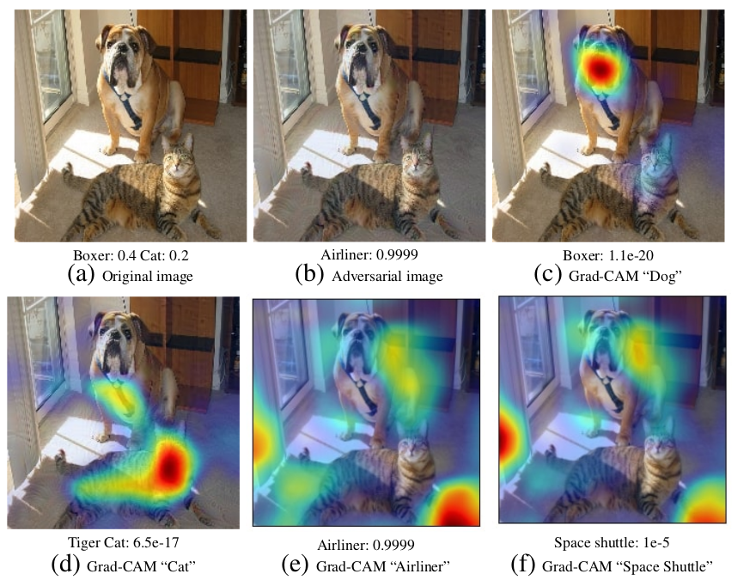
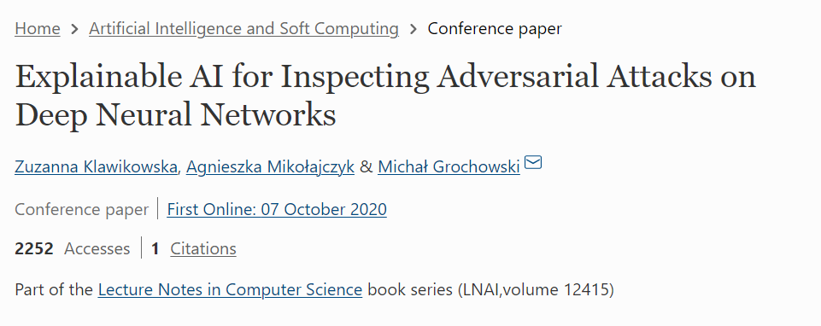
Introduction to eXplainable AI (XAI)
Why is explainability important? As a defense strategy!
https://campusai.github.io/_papers/Grad-CAM/adversarial.png
Notes:
Finally, XAI can also be used as a defense strategy:
When someone conducts an adversarial attack, they try tricking the system by providing an input that – to a human – looks very much like a specific class, say a cat, but, because of subtle changes in the data, gets interpreted by the ML system as another class, say a dog.
XAI tools allow the user to understand which areas of the input image had how much effect on the output creation. These insights can help humans spot images in which the pixels that were focused by the model seem off and, thus, evaluate if an adversarial attack might be happening.
If seemingly random areas of an image shine up and correlate with unexpected output classes, users monitoring the local explanations of their model will notice a dissonance they possibly would’ve missed with their naked eye.
The sooner they’ve noticed something is off, they can check other parameters that confirm or reject an adversarial attack – and timely issue countermeasures, if necessary.
You can also use XAI methods to defend against adversarial attacks: You can imitate an adversarial attack of a particular type – or multiple types – that you render particularly likely and thereby generate adversarial attack input pictures. You can then use these newly created images to re-train your net.
[Transition]
- cool. Now that we’ve learned multiple reasons for why you should care to implement XAI we can look at the workflow :) [hacking and adversarial attacks - use XAI to detect attacks link]

Slide 13







Introduction to eXplainable AI (XAI)
Integration of XAI into your Machine Learning workflow
Input Data
ML / DL Model
Output
Explanation
Example: But there were puzzling findings among them, some readers noticed. Although the work identified many human bacteria in cancerous tissues, there was, in addition to the mysterious seaweed bacterium, a marine hydrothermal vent bacterium linked to prostate cancer, and a coral bacterium associated with melanoma. - Science Insider (https://doi.org/10.1126/science.adk1012)
XAI Method
Domain Knowledge

Slide 14

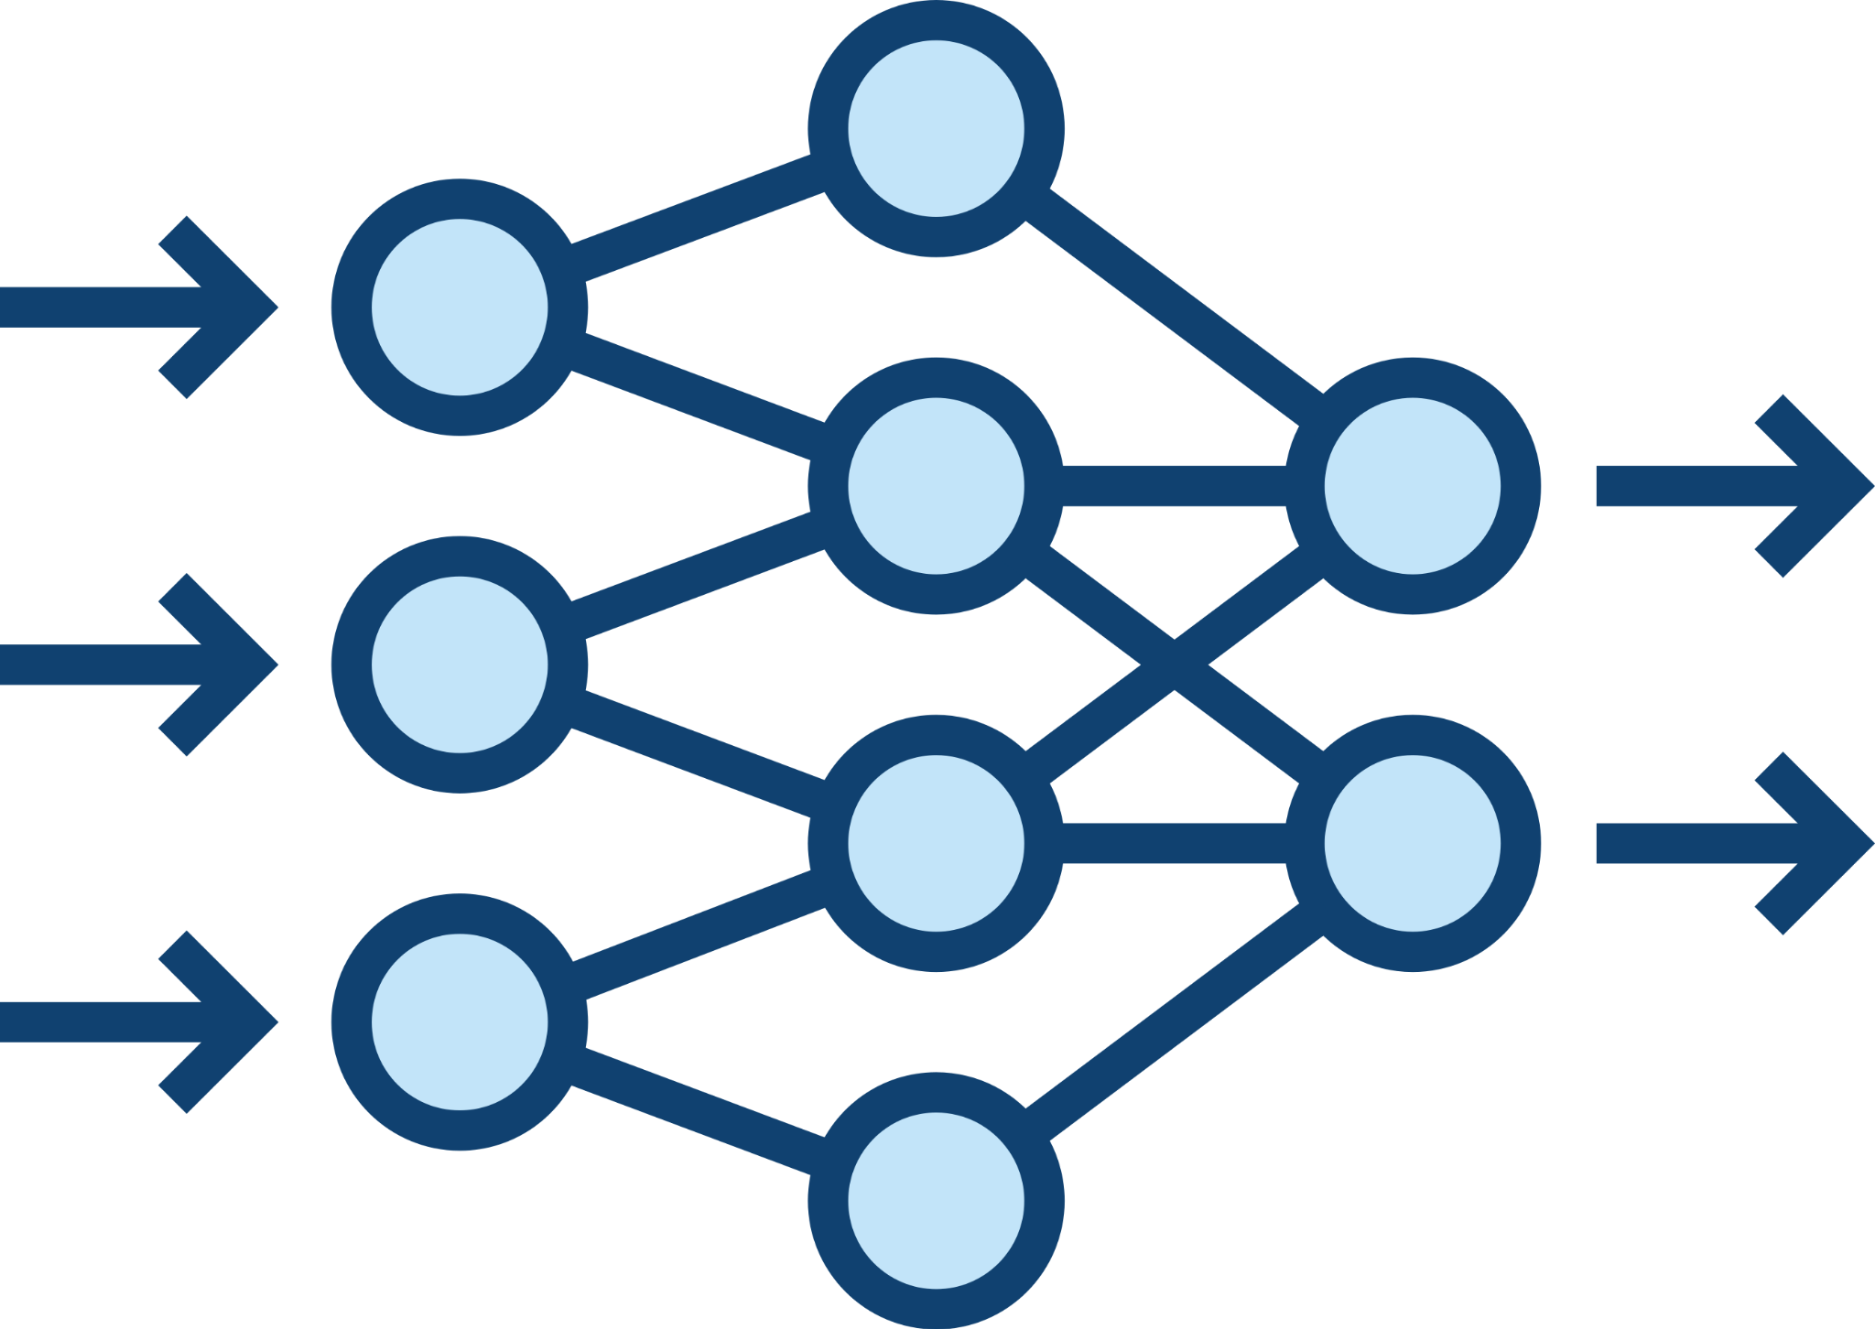
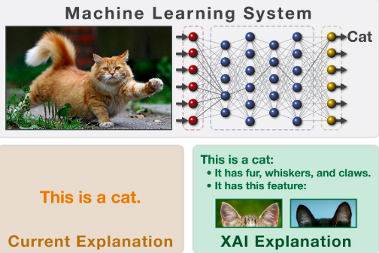
Introduction to eXplainable AI (XAI)
Integration of XAI into your Machine Learning workflow
Current explanation:
This is a cat!
input data
ML / DL model
output
Cat
XAI explanation:
it has fur, whiskers, and claws
it has this feature
XAI method + domain knowledge

Slide 15
Introduction to eXplainable AI (XAI)
Integration of XAI into your Machine Learning workflow
ML model
Is my model directly interpretable?
Interpretability
(intrinsic)
Explainability
(post-hoc)
yes
no
Great! Your model is a glass-box!
Shoot! Your model is a black-box, you should consider XAI methods!

Slide 16



Introduction to eXplainable AI (XAI)
Integration of XAI into your Machine Learning workflow
ML model
model-agnostic
Is my model directly interpretable?
no
Interpretability
(intrinsic)
Explainability
(post-hoc)
Is the interpretation method specific for a certain model type?
yes
no
Does the method describe the average behaviour of the model?
yes
model-specific
local
global
no
yes

Slide 17
Introduction to eXplainable AI (XAI)
Integration of XAI into your Machine Learning workflow
Model-Agnostic
Partial Dependence Plots
Local Interpretable Model-Agnostic Explanations (LIME)
Global Surrogate
Feature Importance
Shapley Values
Global
CAM
Local
Attacking for Interpretability
Integrated Gradients (IG)
Global Attribution Mapping
Attention Maps
Forest-Guided Clustering (FGC)
Grad-CAM
Model-Specific

Slide 18
Introduction to eXplainable AI (XAI)
Integration of XAI into your Machine Learning workflow
Model-Agnostic
Partial Dependence Plots
Local Interpretable Model-Agnostic Explanations (LIME)
Global Surrogate
Feature Importance
Shapley Values
Track 1: XAI for Random Forests
Global
CAM
Local
Attacking for Interpretability
Integrated Gradients (IG)
Global Attribution Mapping
Attention Maps
Forest-Guided Clustering (FGC)
Grad-CAM
Model-Specific

Slide 19
Introduction to eXplainable AI (XAI)
Integration of XAI into your Machine Learning workflow
Model-Agnostic
Partial Dependence Plots
Local Interpretable Model-Agnostic Explanations (LIME)
Global Surrogate
Feature Importance
Shapley Values
Track 2: XAI for CNNs
Global
CAM
Local
Attacking for Interpretability
Integrated Gradients (IG)
Global Attribution Mapping
Attention Maps
Forest-Guided Clustering (FGC)
Grad-CAM
Model-Specific

Slide 20
Agenda
You will move you now into separate breakout sessions with your tutors!
Introduction to eXplainable AI (XAI)
Track 1: XAI for Random Forests
Model-agnostic methods: Perm. Feature Importance, LIME, SHAP
Model-specific methods: Forest Guided Clstering
Comparison of XAI methods for Random Forest models
Track 2: XAI for CNNs
Model-agnostic methods: LIME, SHAP
Model-specific methods: Grad-CAM
Comparison of XAI methods for CNN models
Wrap-Up
GitHub Repository:
https://tinyurl.com/2uta6rdf

Slide 21
Agenda
Introduction to eXplainable AI (XAI)
Track 1: XAI for Random Forests
Model-agnostic methods: Perm. Feature Importance, LIME, SHAP
Model-specific methods: Forest Guided Clstering
Comparison of XAI methods for Random Forest models
Track 2: XAI for CNNs
Model-agnostic methods: LIME, SHAP
Model-specific methods: Grad-CAM
Comparison of XAI methods for CNN models
Wrap-Up

Slide 22
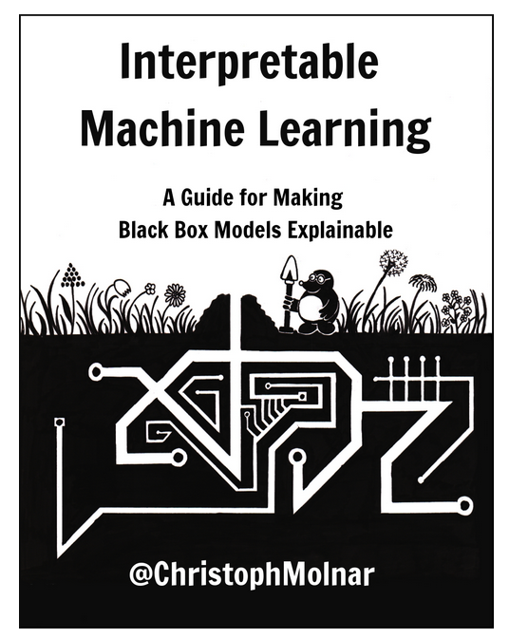


Wrap-Up
Survey
Survey:
https://forms.gle/HcmoCqAcD9DqQ3Tj7
Further Tutorials:
XAI for Transformers
Further Reading

